Slide 1
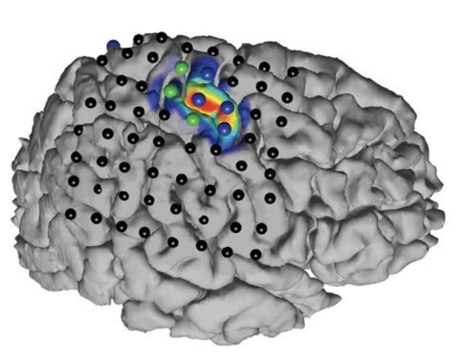
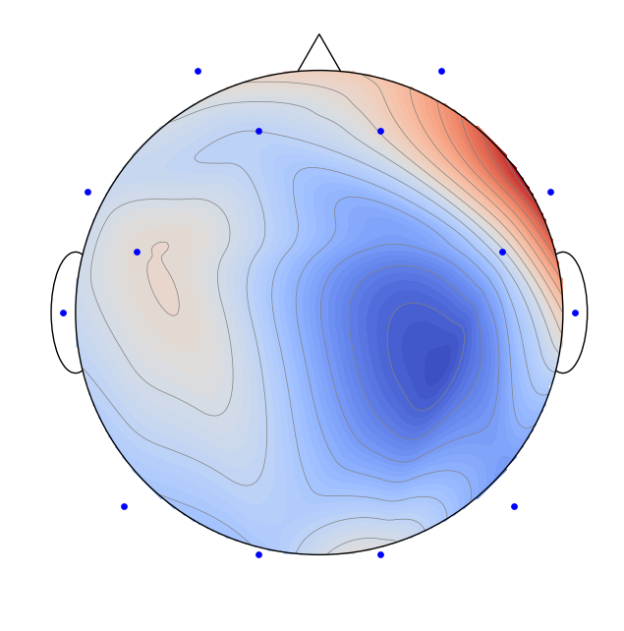
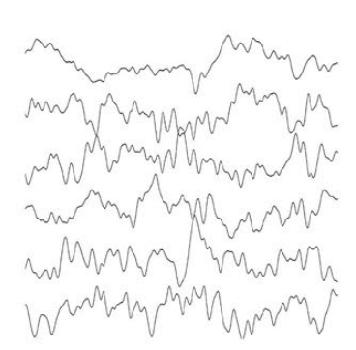

Spatial Filtering for Source Separation in EEG Data
Christian Endl, Felix Wirth, Korbinian Kunst & Taulant Koka

Slide 2
Agenda
Understanding the basis of Source Separation via an intuitive example-driven approach
Discussion of experiment design
Graph Blind Source Separation
Graph Blind Source Separation results
Summary of major outcomes
Problems and future research

Slide 3
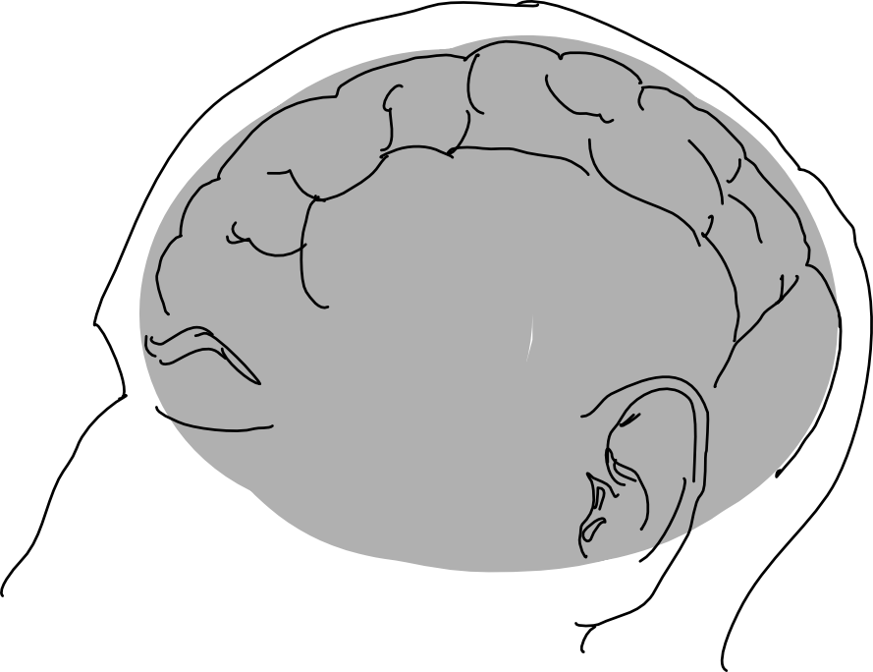
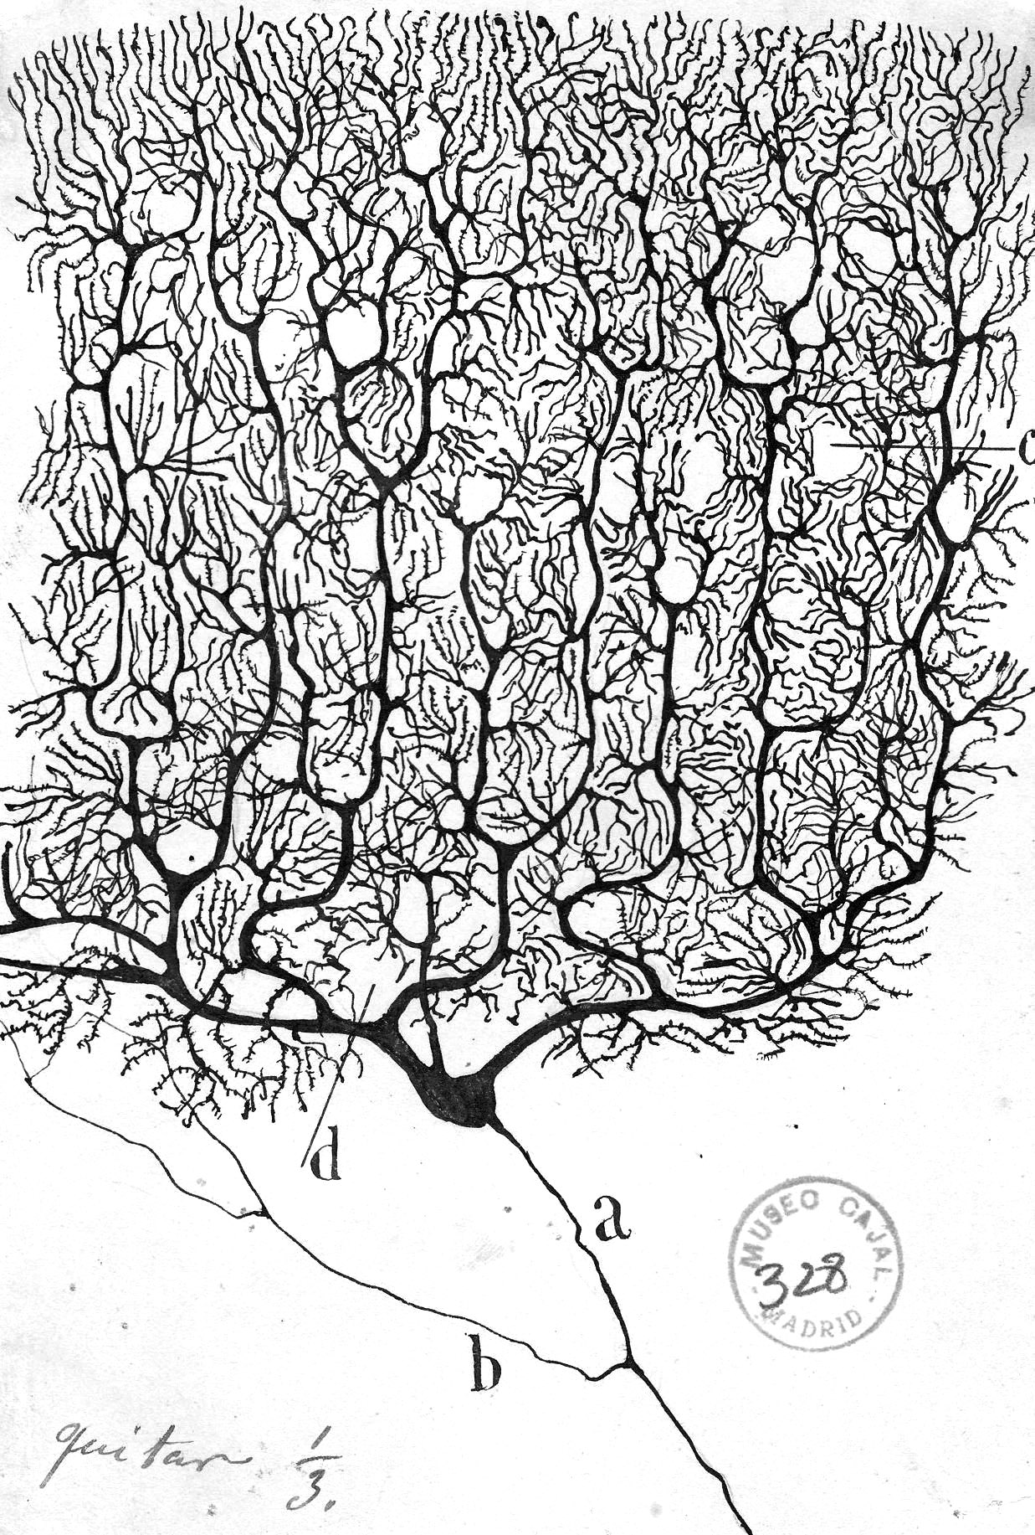
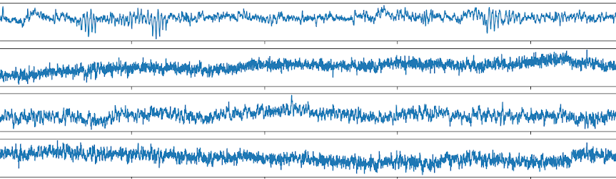
Motivation Challenge of Working with EEG Data
Electroencephalogram (EEG) Concept
What we wish to have?
[BackyardBrains]
We are observing the "oscillating slow fields" of neurons in the upper layers of the cerebral cortex.
These changes in electrical potential lead a neuron to be more likely or less likely to fire action potentials and are important in encoding information in the brain.
What do we get in experiments?
[NY Times, 2020]
“
Working with EEG data is
therefore the process of source separation
EEG Channels
time t in seconds
Notes:
The feature extraction of ICA was motivated by neurosciences that suggest that the similar principle of redundancy reduction explains some aspects of the early processing of sensory data by the brain.

Slide 4

Spatial Filtering for Source Separation Cocktail Party Problem
Def. I: In contrast to temporal filtering in DSP where a signal is analyzed as time-(in)variant subsequent discrete values of one channel, spatial filtering looks at the relation of a given timepoint across multiple channels.
Def. II: The topic of separating mixed sources is called Blind Source Separation (BSS) and can be solved by algorithms called Independent Component Analysis (ICA).
iStock
Notes:
Sosund is particular good example because sound add linearly

Slide 5


The Concept of Source Separation Cocktail Party Problem

Slide 6
The Concept of Source Separation Cocktail Party Problem

Slide 7




The Concept of Source Separation Cocktail Party Problem

Slide 8
The Concept of Source Separation Cocktail Party Problem
Original Signals (Sources)
Sensors
Reconstructed Signals
Latent Variables
Observed Data
Result of the ICA

Slide 9

The Concept of Source Separation Cocktail Party Problem
Original Signals (Sources)
Overlay of Signals
Sensors
Latent Variables
Mixing Matrix
Observed Data
$$S W X$$

Slide 10
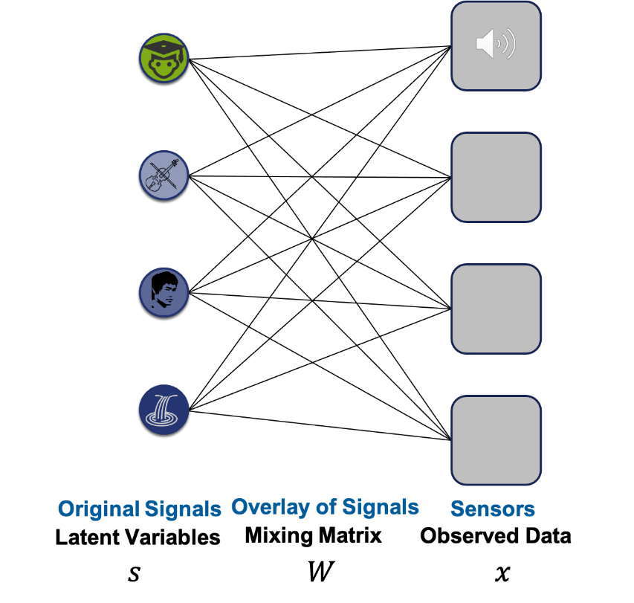

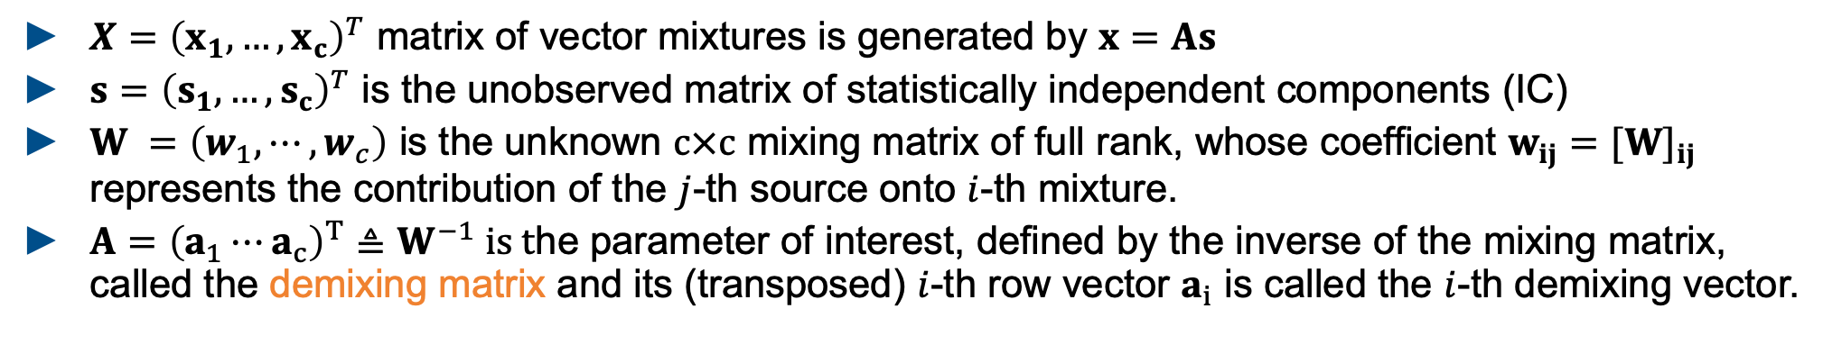

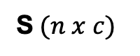

The Concept of Source Separation Math Formulation for ICA (Independent Component Analysis)
S$W=X$
S$(n x c)$
W$(c x c)$
X$(n x c)$
$X={\left(x_{1},…,x_{c}\right)}^{T}$ matrix of vector mixtures is generated by $x=As$
$s={\left(s_{1},…,s_{c}\right)}^{T}$ is the unobserved matrix of statistically independent components (IC)
$W =\left(w_{1},⋯,w_{c}\right)$ is the unknown $c×c$ mixing matrix of full rank, whose coefficient $w_{ij}=[W]_{ij}$ represents the contribution of the $j$-th source onto $i$-th mixture.
$A={\left(a_{1}⋯a_{c}\right)}^{T}≜W^{−1} is t$he parameter of interest, defined by the inverse of the mixing matrix, called the demixing matrix and its (transposed) $i$-th row vector $a_{i}$ is called the $i$-th demixing vector.

Slide 11
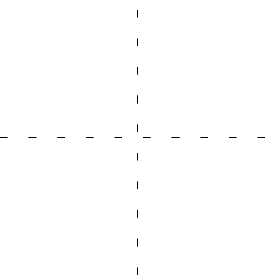

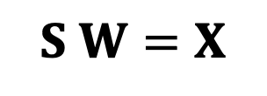
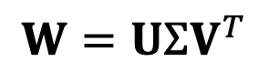

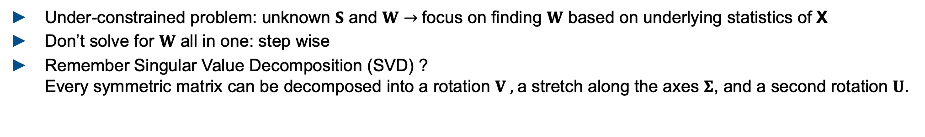

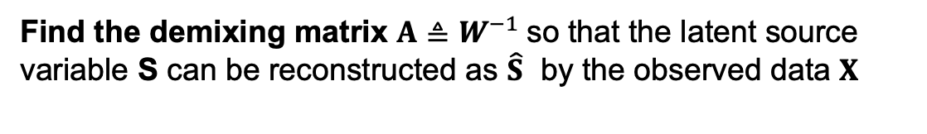


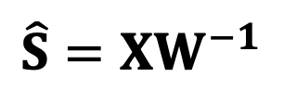


Independent Component Analysis Solving blind source seperation using ICA
What is the goal of the algorithm?
$$S W=X$$
$$\hat{S}=XW^{−1}$$
Find the demixing matrix $A≜W^{−1}$so that the latent source variable S can be reconstructed as $\hat{S}$ by the observed data $X$
How can we find W based on X?
Under-constrained problem: unknown $S$ and $W$ $→$focus on finding $W$ based on underlying statistics of X
Don’t solve for $W$ all in one: step wise
Remember Singular Value Decomposition (SVD) ? Every symmetric matrix can be decomposed into a rotation $V ,$a stretch along the axes $Σ$, and a second rotation $U$.
$$W=UΣV^{T}$$
$A$ $=VΣ^{−1}U^{T}$
$$V^{T}$$
$$Σ$$
$$U$$
$$V$$
$$Σ^{−1}$$
$$U^{T}$$
Notes:
The goal if ICA is to solve BSS problems which arise from a linear mixture
Find two unknowns A and s by only obersving theier matrix product x, underconstrained problem,
Amplitudes
Unsupervised learning problem

Slide 12
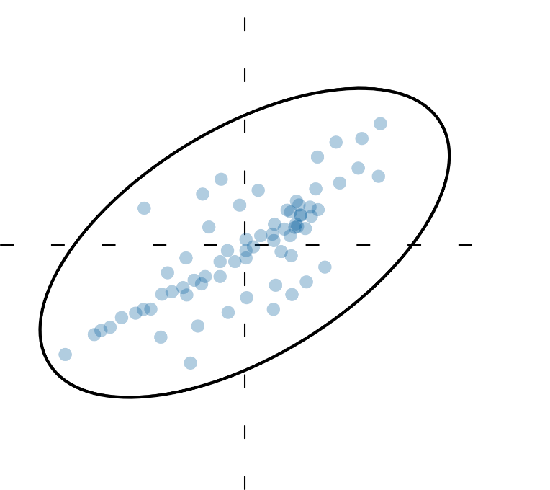
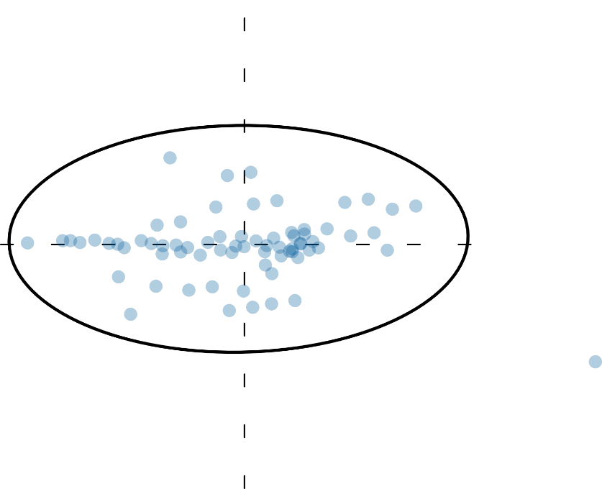
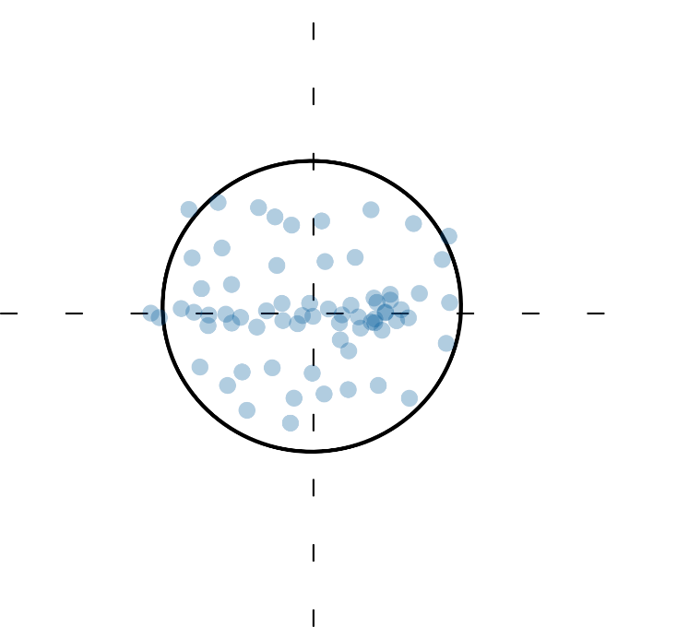
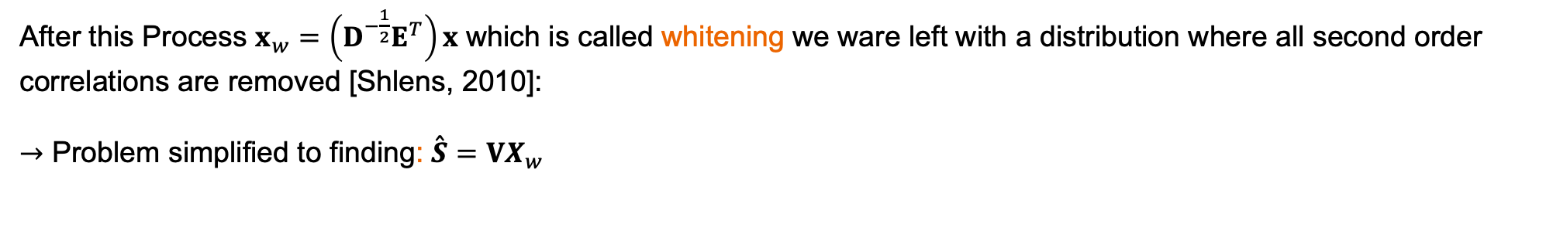


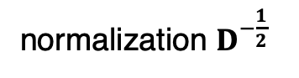

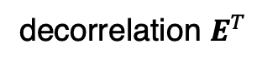

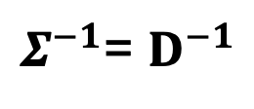
Independent Component Analysis Solving blind source seperation using ICA
If we can find each of the SVD components we can determine the unmixing matrix A
$A$ $=VΣ^{−1}U^{T}$
It can be shown that this can be formulated as an eigenvector problem, where:
$Σ^{−1}$= $D^{−1}$
$$\&$$
$$U^{T}=E^{T}$$
D, E are the singular values and eigenvectors computed from the covariance matrix of X ($Cov= E\left\{XX^{T}\right\}={EDE}^{T}$)
decorrelation $E^{T}$
normalization $D^{−\frac{1}{2}}$
After this Process $x_{w}=\left(D^{−\frac{1}{2}}E^{T}\right)x$ which is called whitening we ware left with a distribution where all second order correlations are removed [Shlens, 2010]:
$→$ Problem simplified to finding: $\overset{ˆ}{S}=VX_{w}$
need to exploit the statistics of independence to identify V
Notes:
The goal if ICA is to solve BSS problems which arise from a linear mixture
Projection the data onto the principal components aka aligning with cartesian coordinates removes linear correlation
Normalizes variance in each direction by multiplying with d^-0.5 => all dimensions are expressed in standard units
V measure of dipendency

Slide 13
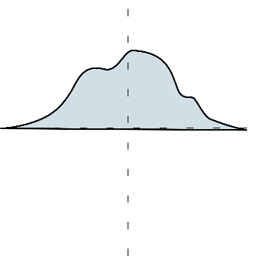
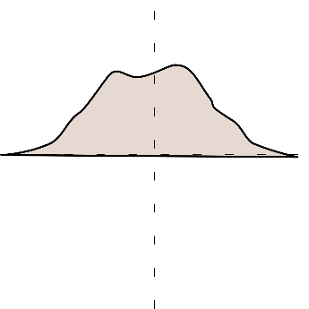
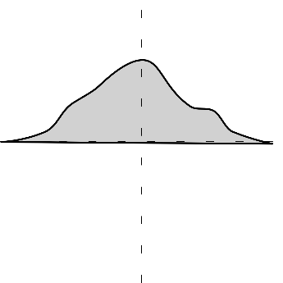
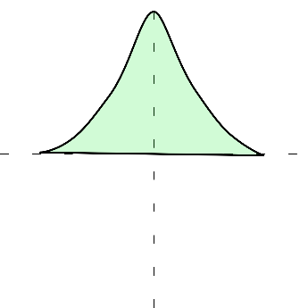

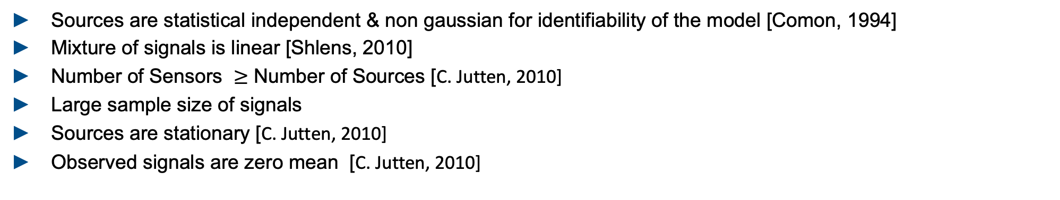

Notes On ICA Assumptions
How to measure statistical independence?
For ICA There are two main approaches [Haykin, 2009] [Hyvarinen, 2000]: a) rooted minimization of mutual information b) maximization of non-Gaussianity
Why is it possible?
$$+$$
$$+$$
Central limit theorem: A mixture of multiple independent random variables (RV) with non-Gaussian distribution will be more Gaussian than each RV individually
Meaning: multiple non-Gaussian distributions tend to form a gaussian distributions
We can use this: Gaussian RV can also be decorrelated to yield independent non-Gaussian components
How can we measure non-Gaussianity ?
Kurtosis, Entropy and measures derived from this [Hyvarinen, 2000]
What are general assumptions for ICA?
Sources are statistical independent & non gaussian for identifiability of the model [Comon, 1994]
Mixture of signals is linear [Shlens, 2010]
Number of Sensors $≥$ Number of Sources [C. Jutten, 2010]
Large sample size of signals
Sources are stationary [C. Jutten, 2010]
Observed signals are zero mean [C. Jutten, 2010]
Notes:
Can also be shown on mutial information (paper verweis, gaussian ist intuitiver, mutial information leads to cleaner mathematical proove
ICA estimation by minimization of mutual information is equivalent to maximizing the sum of non-Gaussianities of the estimates, when the esti- mates are constrained to be uncorrelated.

Slide 14
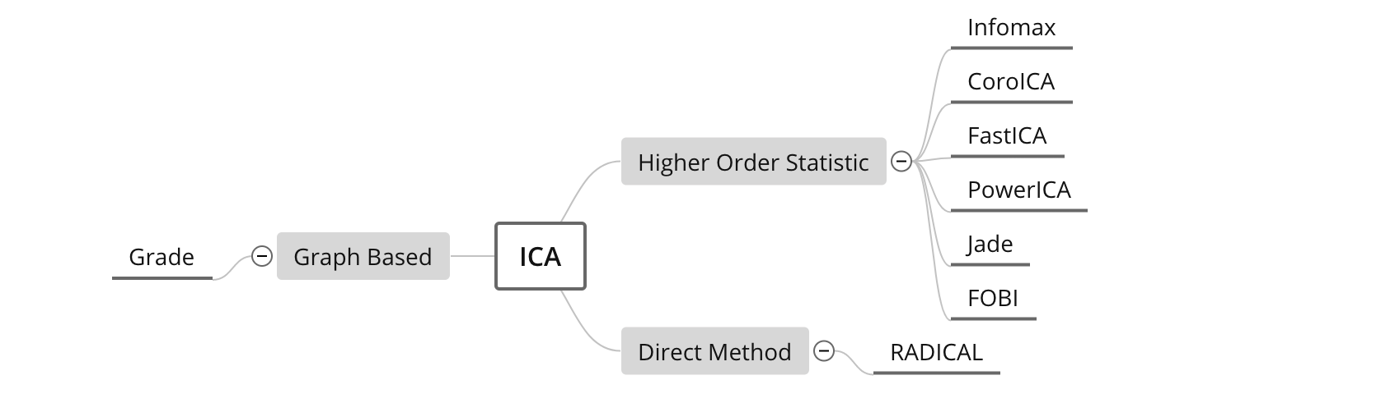
Independent Component Analysis A generic Algorithm description
Quick Summary of the Algorithm:
1. Subtract off the mean of the data in each dimension.
2. Whiten the data by calculating the eigenvectors of the co-variance of the data.
3. Identify final rotation matrix that optimizes statistical independence
Contribution of ICA algo: formulate a contrast function that measures how close the estimated sources are to statistical independence
Reach goal by minimizing or maximizing defined objective
ICA Algorithms – a subjective selective overview:
[Sejnowski TJ , 1995] ]
[Pfister 2019]
[Hyvärinen, 1999]
[Basiri, 2017 ]
[Miettinen, 2020]
[Sejnowski TJ , 1995]
[Cardoso 1993 ]
[Learned-Miller, 2003]
Notes:
Measure for non gaussianity: kurtossis measure for statistically independent Kullback Leibler
Central limit theorem: overlay

Slide 15
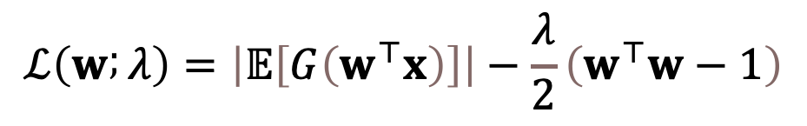
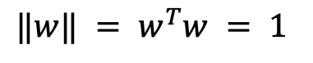
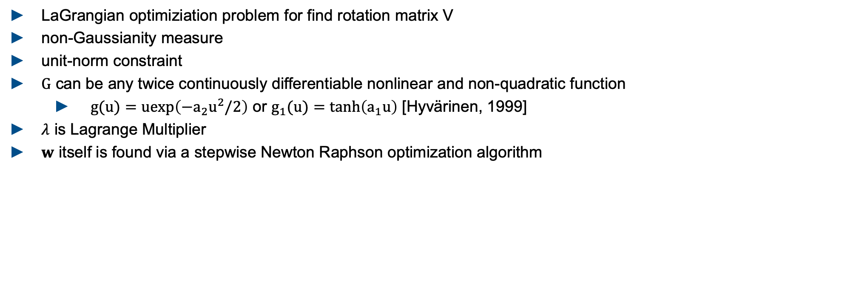
Independent Component Analysis Example Concept PowerICA [Basiri, 2017]
$$ℒ\left(w ; λ\right)=\left|𝔼\left[G\left(w^{⊤}x\right)\right]\right|−\frac{λ}{2}\left(w^{⊤}w−1\right)$$
local maxima
$$‖w‖ = w^{T}w = 1$$
LaGrangian optimiziation problem for find rotation matrix V
non-Gaussianity measure
unit-norm constraint
$G$ can be any twice continuously differentiable nonlinear and non-quadratic function
$g(u)=uexp\left(−a_{2}u^{2}/2\right)$ or $g_{1}(u)=tanh\left(a_{1}u\right)$ [Hyvärinen, 1999]
$λ$ is Lagrange Multiplier
$w$ itself is found via a stepwise Newton Raphson optimization algorithm

Slide 16
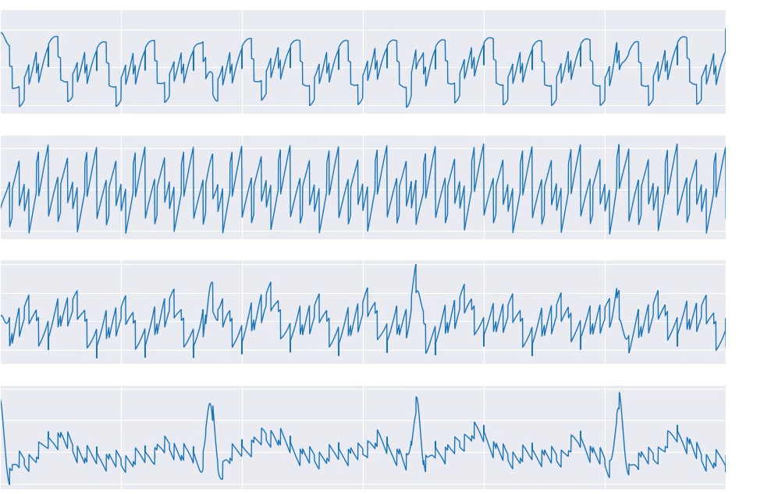
ICA Signal Reconstruction From Mixed Example Signals to Deconstructed Signals
Rectangle
Sin
Saw
ECG

Slide 17
Agenda
Understanding the basis of Source Separation via an intuitive example-driven approach
Discussion of experiment design
Graph Blind Source Separation
Graph Blind Source Separation results
Summary of major outcomes
Problems and future research

Slide 18
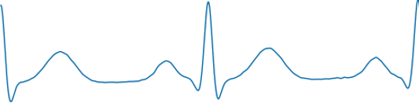
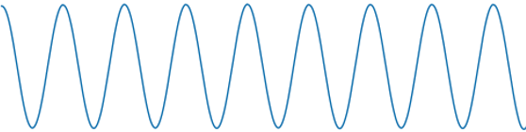
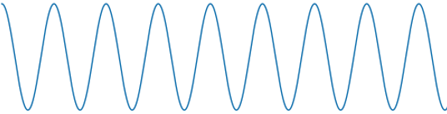
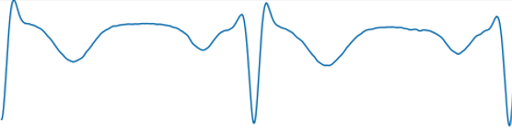
Experiment Design Goal
Goals of this project:
Evaluate ICA - Algorithms in terms of robustness
Elaborating new approaches to increase robustness against noise and outliers in EEG - measurements
How can we evaluate the ICA-Algorithms?
The ICA-Algorithms return the reconstructed signal $\hat{X }$and an estimated mixing matrix $\hat{W}$
2 options: compare input $X$and reconstructed signals $\hat{X }$ or compare mixing matrix $W$ with its estimate $\hat{W}$
$$vs.$$
$$\left(\begin{matrix}0.23 & 0.75 \\ 0.55 & 0.91\end{matrix}\right)$$
$$vs.$$
$$\left(\begin{matrix}0.23 & 0.55 \\ 0.75 & 0.91\end{matrix}\right)$$
$$X$$
$$\hat{X }$$
$$W$$
$\hat{W}$
Problems:
The solution of ICA is not unique: $\hat{A}$ and $\hat{X }$ can pertubed, scaled or have sign changes
Find metrics which deal with that

Slide 19
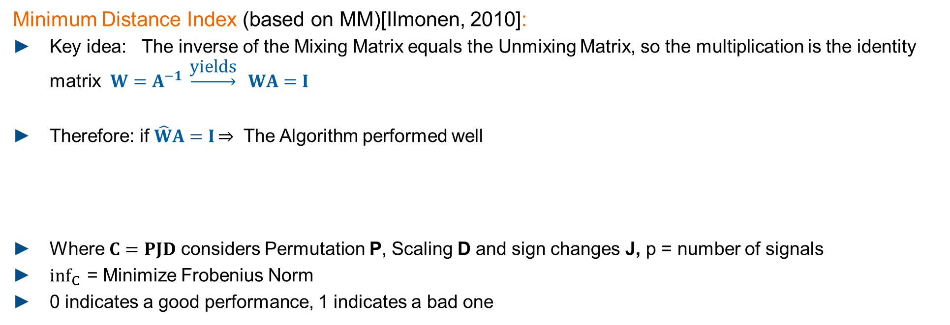
Experiment Design Metrics: MD, MSE
Minimum Distance Index (based on MM)[Ilmonen, 2010]:
Key idea: The inverse of the Mixing Matrix equals the Unmixing Matrix, so the multiplication is the identity matrix $W=A^{−1} \underset{→}{\text{yields}} WA=I$
Therefore: if $\hat{W}A=I\overset{⇒}{}$ The Algorithm performed well
Where $C=PJD$ considers Permutation P, Scaling D and sign changes J, p = number of signals
$inf_{C}{ }$= Minimize Frobenius Norm
0 indicates a good performance, 1 indicates a bad one
$$MD=\frac{1}{\sqrt{(p−1)}}⋅inf_{c}{{\left\|C\hat{W}A −I \right\|}_{2}}$$
Mean squared Error (MSE):
Taking the Mean of the squared residuals
Obtained values = number of signals take mean or median
Problem:
Required groundtruth data for X and W
residuals

Slide 20
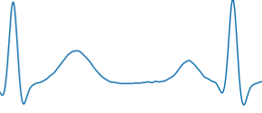
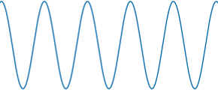
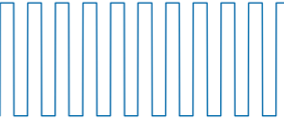
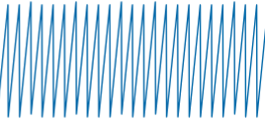
Experiment Design General approach
What we did:
We generated ideal Input Signals $X∈ ℝ^{4xN}$ and a random Mixing Matrix. $W ∈ ℝ^{4x4}$ groundtruth
From us defined Standard Signals
Groundtruth mixing matrix $W$
$$\left(\begin{matrix}0.11 & 0.34 & 0.77 & 0.24 \\ 0.41 & 0.91 & 0.63 & 0.49 \\ 0.99 & 0.56 & 0.23 & 0.33 \\ 0.38 & 0.45 & 0.03 & 0.23\end{matrix}\right)$$
$W$ =
Frequencies of Brainwaves
[Koudelková2018] :
ECG Signal: 2Hz
Sinus: 5Hz
Rectangle: 10Hz
Sawtooth: 25Hz
fs: 1000Hz
Normalized to [-1,1]
$δ−Waves:0.5−3Hz$
$θ−Waves:3−8Hz$
$α−Waves:8−12Hz$
$β−Waves:12−38Hz$

Slide 21
Experiment Design Monte Carlo Flow Chart
Input Signals
Standard input signals
ECG, Sinus, Rectangle, Sawtooth
Runs = 1000
2. Mix Signals with mixing matrix $W$(random)
$W ∈ ℝ^{4x4}$
Mix Signals
Contaminate Signals
3. Contaminate signals
Add single or patchy Outlier (100std) and/or white noise (40dB)
Whitening
4. Whitening process
Decorrelate Signals: meaning that the sample covariance matrix is diagonal and that all the diagonal elements are equal.
ICA
5. Perform ICA
4 Algos: JADE, RADICAL, CoroICA, PowerICA
$$\hat{X}$$
$$\hat{W}$$
Evaluate on Metrics
6. Evaluate single run
Minimum Distance, MSE
7. Evaluate ICA
Get 1000 MDs and MSEs.
Empirical Data Analyses
BoxPlot

Slide 22

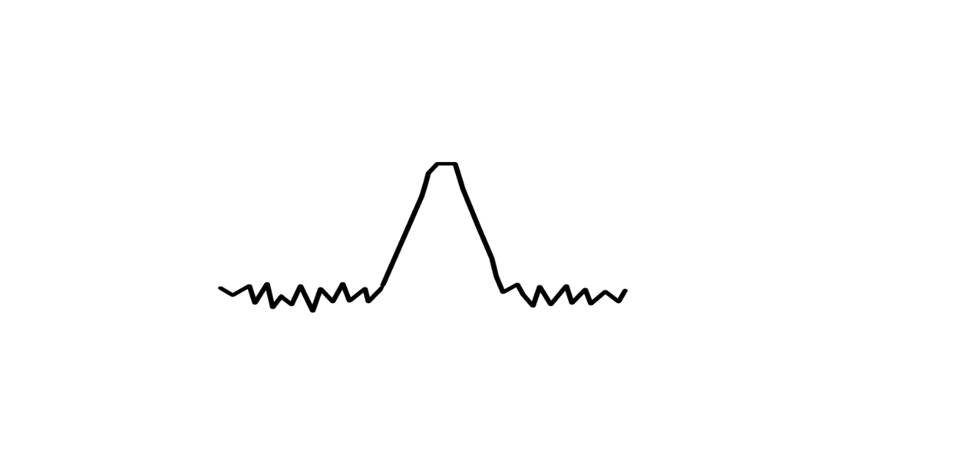

Experiment Design Definition of test characteristics
1.) Focus on Sample Size
Initialize standard signals with different Sample Sizes: 1000, 2500, 5000, 10000, 15000 evaluate on 1000runs
N
Type I: No Noise, No Outlier
Type II: 40dB SNR, No Outlier
Type III: No Noise,
0.1% Outlier(std = 100)
Type IV: 40dB SNR,
0.1% Outlier (std = 100)
2.) Focus on amount of noise – Breakdown Analyses
Initialize standard signals with fix Sample Size of 10000
Type V: increase noise, SNR: 40 dB,
30 dB, 20 dB, 10 dB, 6 dB, 3 dB
Notes:
ICONS !!!

Slide 23





Results Interpreting the Minimum Distance
MD = 0.4
$$⋅W=$$
$$⋅{\hat{W}}^{−1}=$$
MD = 0.6
$$MD=0.2$$
$MD=0.2$ : Good results, small spikes, some sign changes
Notes:
MD not linear ..

Slide 24

Results Interpreting the Minimum Distance
MD = 0.4
$$⋅W=$$
$$⋅{\hat{W}}^{−1}=$$
MD = 0.6
$$MD=0.4$$
$MD=0.2$ : Good results, small spikes, some sign changes
$MD=0.4$: signals are recognizable, bigger spikes

Slide 25

Results Interpreting the Minimum Distance
$$⋅W=$$
$$⋅{\hat{W}}^{−1}=$$
$$MD=0.6$$
$MD=0.2$ : Good results, small spikes, some sign changes
$MD=0.4$: signals are recognizable, bigger spikes
$MD=0.6$: not all signal reconstructed, bigger spikes
Notes:
MD no linear measure – see 0.4 to 0.6

Slide 26


Experiment results Type 1
PowerICA – Type 1: No Noise, No Outlier
Sample Size 10000
0.6
Type 1 (ideal) | Median MD | Median MSE
PowerICA | $$0.21±0.001$$ | $$0.0039±0.0002$$
Jade | $$0.21±0.03$$ | $$0.0077±0.002$$
CoroICA | $$0.06±0$$ | $$0.0009±0$$
Radical | $$0.03±0.006$$ | $$0.0001±4.86$$
MD
0.4
0.2
0.2
MSE
0.1
0.0
1000
2500
5000
10000
15000
Sample Size
Pros:
All Algorithms are able to reconstruct the source signals
Cons:
Radical: Long runtime unusable for real time processing
CoroICA: Only good results for tested signals by Hyperparameter tuning
Notes:
Explain Plot, Examplarly plotted PowerICA here,
MD and Mse are going down for higher samples sizes
All Algorithms were good in the ideal case, shown here are the MDs and MSEs for all algorithms
And now we look on type 1-4

Slide 27
Experiment results Type 1 - 4
PowerICA – Type 1: No Noise, No Outlier
Sample Size 10000
0.6
PowerICA | Median MD | Median MSE
Type 1 (ideal) | $$0.21±0.001$$ | $$0.0039±0.0002$$
Type 2 (noise) | $$0.18±0.006$$ | $0.0034$ $$± 0.0004$$
Type 3 (outlier) | $$0.81±0.06$$ | $$0.36±0.1$$
Type 4 (noise + outlier) | $$0.81±0.06$$ | $$0.35±0.1$$
MD
0.4
0.2
0.2
MSE
0.1
0.0
1000
2500
5000
10000
15000
Sample Size
Sample Size of min. n = 5000 is necessary
For 40dB SNR variance increases slightly, more outliers
Even 0.1% Outlier causes failure for every algorithm
Hop at 10000: Drawback of the MD – metric is not perfect
Next Step:
Breakdown Analyses – How much noise does it take to cause a breakdown?

Slide 28


Experiment results Type 5
Power ICA – Type 5: 3-40dB Noise, No Outlier
0.8
Type 5:
Noise < 20dB SNR $→$ breakdown
MD
0.6
0.4
0.2
Did our robustness plugins improve the results ?
0.6
0.4
Robust Covariance Estimation in Whitening:
Could not prevent breakdown
Occasionally causes breakdown
Robust objective Function in higher Order statistics:
Could not prevent breakdown
Occasionally causes breakdown
MSE
0.2
0.0
3.0
6.0
10.0
20.0
30.0
40.0
SNR (additive noise)
Intermediate conclusion:
Pre-processing of the data essential! $→$Outlier removal + smoothing
We need new approaches to improve the performance
Notes:
We decreased SNR from 40dB to 3db …

Slide 29
Agenda
Understanding the basis of Source Separation via an intuitive example-driven approach
Discussion of experiment design
Graph Blind Source Separation
Graph Blind Source Separation results
Summary of major outcomes
Problems and future research

Slide 30



Shortcomings
Significant performance loss for sample sizes with N << 5000
Unable to recover more than one Gaussian signal
For SNR ≤ 20dB high variance in performance
Failures become increasingly likely
Inherently unrobust against outliers
A single outlier will lead to failure of the method
N
1. Samples
2. Gaussian
3. SNR ≤ 20dB
4. Outlier
Notes:
As Korbinian pointed out:
we observe several deficits of the method ,which are cloesly related to the assumptions we made for ICA in general
First the Algorithm struggled with low numbers of observations of the signals,we needed at least 5000 to perform consistently well
Secondly, we can’t recover more than one gaussian signal, due to the assumptions we placed upon the source signals
Furthermore, if SNR < 20dB, the number of failures increases drastically
Lastly, early Breakdown for a single outlier
Raises the Question: What other approaches to ICA are there?

Slide 31


Recent Developments
In 2010: Blind Source Separation(BSS) using graph theory [Blöchl, 2010]
In 2020: First approaches to combine non-Gaussianity based BSS with graph based BSS (Jari Miettinen et al.) [Miettinen, 2020]
What is the idea?
Design a method that uses:
Non-Gaussianity measure (classic ICA)
Notes:
In 2010 a research team from Helmholtz Research Center came up with a method to use graph theory based Signal Separation
10 years later - > Aalto research group around Esa Ollila and Jari Miettinen came up with an approach to combine this graph based Method with non-Gaussianity based ICA by:
Maximizing some Non-Gaussianity measure and

Slide 32

Recent Developments
In 2010: Blind Source Separation(BSS) using graph theory [Blöchl, 2010]
In 2020: First approaches to combine non-Gaussianity based BSS with graph based BSS (Jari Miettinen et al.) [Miettinen, 2020]
What is the idea?
Design a method that uses:
Non-Gaussianity measure (classic ICA)
Information about underlying graph structure
Combine those in a way that they complement each other
Notes:
Information about some network topology
At first this sounds very appealing, but one might ask: What are graphs?

Slide 33


Graph Blind Source Separation What are Graphs?
Notes:
In the following: A short introduction to the concepts of graph theory and signal processing we worked with

Slide 34

Graph Blind Source Separation What are Graphs?
Graphs are structures build by vertices that are connected by edges
Edges represent proximity between two vertices
Graph structure can be stored in a matrix ⇒ The adjacency matrix A [Djuric, 2018]
Examples: Social networks, sensor networks, brain networks, etc.
0 1 1 1 1 1 1
7
2
1 0 0 0 0 0 0
1 0 0 0 0 0 0
$A$ =
1 0 0 0 0 0 0
6
1
3
1 0 0 0 0 0 0
1 0 0 0 0 0 0
4
1 0 0 0 0 0 0
5
Undirected unweighted graph
Notes:
A Graph is a set of vertices/nodes that is connected by some edges
The edges represent some kind of proximity or closeness of the nodes
Example Facebook/Instagram: Each member is a vertex, each friendship or follower is an edge
Edges may be directed or undirected
Undirected: If I am friends with Korbinian or Felix on Facebook, it means they are also friends with me => the friendship is mutual)
Directed: If I follow someone on Instagram it doesn’t mean they necessarily follow me to
These graphs can become quite complex, so we need a method to compactly store the information about the topology of the graph
This can be done with an adjacency matrix

Slide 35




Graph Blind Source Separation What are Graphs?
Graphs are structures build by vertices that are connected by edges
The Entry $A_{i,j}$represents the edge status between node i and j
$$A_{i,j}{\left.​\right|}_{i=1,j=7}$$
0 1 1 1 1 1 1
7
2
1 0 0 0 0 0 0
1 0 0 0 0 0 0
$A$ =
1 0 0 0 0 0 0
6
1
3
1 0 0 0 0 0 0
1 0 0 0 0 0 0
4
1 0 0 0 0 0 0
5
Undirected unweighted graph
$$A_{i,j}{\left.​\right|}_{i=7,j=1}$$
Notes:
each i,jth entry of the Adjacency matrix represents the edge between nodes i and j

Slide 36

Graph Blind Source Separation Graph Signals
Analogy to discrete time signals
Simplest case: Recursive Line Graph
Each node represents a sample point
Directed graph ⇒ unsymmetric adjacency [Djuric, 2018]
1
2
3
4
…
N
n ∈ ℕ, n ≤ N
0 1 0 0 0 0 … 0
0 0 1 0 0 0 … 0
0 0 0 1 0 0 … 0
$A$ =
0 0 0 0 1 0 … 0
. . . . . . … 0
0 0 0 0 0 0 … 1
1 0 0 0 0 0 … 0
Notes:
Now that we know Graphs, we can introduce the concept of Signals on graphs
Actually we already know one => the structure of discrete time signals can be represented by an underlying Line graph, in the case of periodic signals it would be a recursive or cyclic line graph as shown here
This graph is directed (because flow of time is directed) => leads to A unsymmetric
In this representation each node of the Graph stands for a time instance of the Signal

Slide 37
Graph Blind Source Separation What are Graph Signals?
Analogy to discrete time signals
Simplest case: Recursive Line Graph
Multiple Signals can share the same graph
In this case: The class of all periodic signals with period N
1
2
3
4
…
N
n ∈ ℕ, n ≤ N
0 1 0 0 0 0 … 0
0 0 1 0 0 0 … 0
0 0 0 1 0 0 … 0
$A$ =
0 0 0 0 1 0 … 0
. . . . . . … 0
0 0 0 0 0 0 … 1
1 0 0 0 0 0 … 0
Notes:
Examples of corresponding edges in the Adjacency matrix are depicted in colors ( green to last node, orange to first node)
It is important to note, that there can be various signals that share the same graph structure
In this case that: all periodic signals with Period of length N
Now that we have established what graph signals are, we can go ahead and define the Graph Shift

Slide 38

Graph Blind Source Separation What are Graph Signals?
Analogy to discrete time signals
Simplest case: Recursive Line Graph
We call ${XA}^{k}=X^{(k)}$ a graph shift by k
For Line Graph ⇔ Shift operator as known from Digital Signal Processing
When a graph shift is applied, the signal will shift along every connected path made up of the k nearest edges. [Djuric, 2018]
k = 1 shift
1
2
3
4
…
N
n ∈ ℕ, n ≤ N
Notes:
Graph Shift analog to the Shift Operator known from Digital Signal Processing:
In fact it is the same, for this type of Line Graph
This Propagation of the Signal through the graph, can be achieved by multiplication of the Signals X with the Adjacency Matrix A^k , where k is the length of the shift
So we can state that graph shift by k will propagate the signal along every connected path along the k nearest outgoing edges
Let‘s see what would happen, if we had an edge going from node 0 to node 3

Slide 39
Graph Blind Source Separation What are Graph Signals?
Analogy to discrete time signals
Simplest case: Recursive Line Graph
We call ${XA}^{k}=X^{(k)}$ a graph shift by k
For Line Graph ⇔ Shift operator as known from Digital Signal Processing
When a graph shift is applied, the signal will shift along every connected path made up of the k nearest edges. [Djuric, 2018]
k = 1 shift
1
2
3
4
…
N
n ∈ ℕ, n ≤ N
Notes:
As you can see, having additional connections between nodes will lead to a linear combination of the values of the signal that have been propagated through the incident edges into a node
In this case we have added up the values shifted from node 0 and node 2 into node 3
With all of this we are now able to define the Graph autocorrelation

Slide 40


Graph Blind Source Separation Graph Autocorrelation
Using the introduced graph shift we define the graph autocorrelation matrix analog to the sample autocorrelation [Blöchl, 2010] :
$C_{X}^{Sample}≔\frac{1}{N−1}$ $XX^{T}$
$C_{X}^{Graph}\left(k\right)≔\frac{1}{N−1}X^{(k)}X^{T}=\frac{1}{N−1}XA^{k}X^{T}$
$C_{X}^{Sample} ∈{\text{ℝ}}^{D ×D}:$ D dimensional square matrix of sample autocorrelation
$C_{X}^{Graph}\left(k\right) ∈{\text{ℝ}}^{D ×D}:$ D dimensional square matrix of graph autocorrelation for k graph-shifts
$A^{k}∈{\text{ℝ}}^{N ×N}:$ k-th power of adjacency matrix corresponding to k shifts along the graph
$X=(x_{1}, x_{2},…x_{D})∈{\text{ℝ}}^{N × D}:$ D signals stored as column vectors
The k-shift along paths of an underlying graph can provide additional information about the source signals!
$=\frac{1}{N−1}$ $XIX^{T}$
$A^{k}{\left.​\right|}_{k=0}=I$ ,
$I$ $∈{\text{ℝ}}^{N ×N}$: Identity Matrix
Notes:
Analog to the sample autocorrelation matrix, which equals the sample covariance matrix because we have centered our data beforehand to have zero mean
We can define the graph autocorrelation as the correlation between the Signals X and the signals X at a lag k, meaning that it has been shifted by k through the graph
With that in mind it is easy to see that for k = 0 our Shift Operator will be equal to the Identity matrix and we end up with the sample autocorrelation matrix ,
This shift through the Graph, provides us with additional information about our sources, if they follow some other order than just the line-graph
Having this Information, we can use a decorrelation method to seperate our signals

Slide 41




Graph Blind Source Seperation Graph Decorrelation
Find a matrix $W$ that diagonalizes $WC_{X}^{Graph}W^{T}$ as much as possible [Blöchl, 2010]
The solution for $W$ decorrelates the signals $X$ in the graph-sense
$W$ is an estimate for the solution of the BSS problem for graph-signals
Advantages | Disadvantages
Independent of data distribution | Graph structure not directly available
Works well with small sample sizes | Highly dependent on accurate graph
Graph structure in many real- world problems
N
Notes:
That, we do by finding a matrix W which diagonalizes our graph autocorrelation as much possible
In all of this we asssume whitened data
Then, W is an estimate for the Solution of the Source Separation Problem
This Method, has some noteworthy advantages:
Unlike ICA it does not presume any specific distribution of the signals, meaning it works with gaussian signals as well
The sample sizes can be much lower, (performs well with 1000 samples already)
There are numerous underlying network topologies in real world problems
However, these graph structures are most of the time not directly available and need to be inferred by some method
Therefore it is a major disadvantage, that the performance of the algorithm is highly dependent on accurate graph estimations

Slide 42
Graph Blind Source Seperation Graph Decorrelation
PowerICA shortcomings:
Significant performance loss for sample sizes with N << 5000
Unable to recover more than one Gaussian signal
Advantages | Disadvantages
Independent of data distribution | Graph structure not directly available
Works well with small sample sizes | Highly dependent on accurate graph
Graph structure in many real- world problems
N
Graph based BSS and non-Gaussianity based BSS seem to make up for each others weak points.
Notes:
Comparing this with the shortcomings of PowerICA adressed earlier it seems that they complement each other
So the Question is, how do we combine them?

Slide 43





Graph Blind Source Seperation Composite Objective
How can we combine them?
Approach from Jari Miettinen et al. (Aalto University) [Miettinen, 2020]
Define composite objective function $f_{composite}$:
PowerICA objective:
Maximize estimate of non-Gaussianity with the Lagrangian method.
$$\text{(1−}\text{λ}\text{)}$$
+
Composite objective function $f_{composite}$
Graph decorrelation objective:
Diagonalize graph autocorrelation matrix(matrices) as much as possible. For only one adjacency ⇒ eigenvalue problem.
$$\text{λ}$$
Balance Parameter
$$\text{0 < }\text{λ}\text{ < 1}$$
Notes:
As mentioned earlier the group around Miettinen, came up with a method.
Considers first the two objective functions of
An ICA objective, which we chose to be PowerICA, that tries to separate the signals by maximizing non-Gaussianity
The Graph decorrelation objective, which is the diagonalization process of the graph autocorrelation
We cannot simply add them up as they are, but by introducing a new parameter lambda, that balances the two objective functions, we arrive at the composite objective function
And how this concept perfermoed, will be shown to you by Christian

Slide 44
Literature
[Miettinen, 2020] Graph Signal Processing Meets Blind Source Separation, Jari Miettinen, Esa Ollila et al., 2020
[Blöchl, 2010] Second-Order Source Separation Based on Prior Knowledge Realized in a Graph Model, Florian Blöchl, Andreas Kowarsch, Fabian J. Theis, 2010
[Djuric, 2018] Cooperative and Graph Signal Processing Principles and Applications, Petar Djuric, Cédric Richard, 2018

Slide 45
Agenda
Understanding the basis of Source Separation via an intuitive example-driven approach
Discussion of experiment design
Graph Blind Source Separation
Graph Blind Source Separation results
Summary of major outcomes
Problems and future research

Slide 46



Graph BSS Results Clean data
Standard signals (Cos, Rect, ECG, Saw)
Clean data: Better results than standard Power ICA (1000 samples)
Power ICA
Input signals
Graph Power ICA

Slide 47

Graph BSS Results Clean data
Standard signals (Cos, Rect, ECG, Saw)
Clean data: Better results than standard Power ICA (1000 samples)
Power ICA
Graph Power ICA
0,6
0,4
MD
0,19
0,1
0,6
MSE
0,1

Slide 48


Graph BSS Results Noisy data
Power ICA
Comparable for noisy signals (up to 20dB SNR)
Input signals
Graph Power ICA

Slide 49

Graph BSS Results Noisy data
Comparable for noisy signals (up to 20dB SNR)
Power ICA
Graph Power ICA
0,8
MD
0,38
0,2
0,8
MSE
0,2

Slide 50


Graph BSS Results Outlier contamination
Breakdown point already with one large outlier (100std)
Power ICA
Input signals
Graph Power ICA

Slide 51

Graph BSS Results Outlier contamination
Breakdown point already with one large outlier (100std)
Power ICA
Graph Power ICA
1,0
MD
0,8
0,4
1,4
MSE
0,4

Slide 52


Towards EEG data Synthetic EEG artifact reconstruction
Semi-synthetic EEG data:
1. Use real EEG data as input signals
EEG data:
2. Mix Data with random mixing matrix
3. We generated realistic artifacts and added one on each channel
Artifacts which typically come along with EEG data [Delorme2006]
Optional: Add single or patchy (1000std) Outliers and white noise (3std)
Synthetic EEG artifacts:
Eye Blink
Muscle
4. Perform Power ICA and Graph Power ICA
Electrical
Electrical
Notes:
Show reconstructed artifacts

Slide 53



Graph BSS Results Semi-synthetic EEG data
Artifacts clearly extractable:
Power ICA
EEG artifacts
Eye Blink
Muscle
Electrical
Electrical
Noise
0
1
2
3
4
5
6
0
1
2
3
4
5
6
t[s]
t[s]

Slide 54

Graph BSS Results Semi-synthetic EEG data
Also possible with Graph Power ICA:
Power ICA
Graph Power ICA
0
1
2
3
t[s]
4
5
6
0
1
2
3
t[s]
4
5
6

Slide 55
Graph BSS Results Semi-synthetic EEG data
Events clearly extractable:
Power ICA
Button push
Visual stimulus
0
1
2
3
t[s]
4
5
6

Slide 56
Agenda
Understanding the basis of Source Separation via an intuitive example-driven approach
Discussion of experiment design
Graph Blind Source Separation
Graph Blind Source Separation results
Summary of major outcomes
Problems and future research

Slide 57
Summary of major outcomes
Question 1: What is ICA?
Question 2: How to compare algorithms?
Question 3: Which algorithm performs best? What happens with noise or outlier?
Question 4: How to robustify algorithms?
Question 5: What is Graph Signal processing / Graph BSS?
Question 6: Outcomes of Graph Signal processing?

Slide 58

Summary of major outcomes Question 1: What is ICA?
Mathematical concept to extract (independent = non-gaussian) signals from mixed signals
Different approaches to obtain the demixing matrix → 4 algorithms
„ICA tries to decorrelate mixed up signals and find the optimal demixing matrix based on optimizing different measures of independence“
CoroICA

Slide 59

Summary of major outcomes Question 2: How to compare algorithms?
Minimum distance, MSE and SNR
Correlation of different metrics important
„One Metric sometimes provides not the whole information: We need to find how different metrics correlate“
0,8
Power ICA
Graph Power ICA
0,6
0,6
MD
0,4
0,4
Median of MSEs
0,2
0,19
0,0
0,1
0,0
0,2
0,4
0,6
0,8
1,0
Minimum Distance

Slide 60
Summary of major outcomes Question 3: Which algorithm performs best? What happens with noise or outlier?
Monte Carlo run with 10.000 runs: Evaluate metrics
More or less similar with good data (simulated and real EEG data with added artifacts)
Power ICA: quite good with reasonable SNR (~ 20dB), fast and with low variance
Low sample sizes are problematic (< 5000 samples)
Higher noise than 20dB SNR: smoothly becoming worse
All reach breakdown point with one large outlier
„All four algorithms: Good performance on well behaving data but higher noise level or larger outlier cause
failure ➔ Violates assumptions“
Notes:
Low sample size problematisch: central limit theorem → finite variance (ausreißer macht infinite variance)
Gaussian noise (gegen die Annnahmen von ICA)
Ergebnisse machen Sinn: Annahmen über ICA
Robustness nicht gegeben, da asymptotisches Verhalten verändert
Assumptions sagen!
iid, finite covariance, dürfen nicht Gauss sein

Slide 61
Summary of major outcomes Question 4: How to robustify?
Whitening process crucial for algorithms
Different objective functions for some algorithms
Initialization quite important (local maxima/minima)
Within algorithms: quite complicated → model based
What we tried:
Plug-in robustness of covariance estimation in whitening process
Trying out different robust objective functions
Initialize Power ICA with Radical as a global optimizer
„No real improvement: sometimes with noise a bit better, but still low
breakdown point”
Notes:
Robust whitening: probem mit outlier
Problem mit outlier: Unterschied non-Gaussian signals und non-Gaussian outlier
Annahmen verletzen -> ist sinnvoll das es nicht funktioniert
=> Model gibt es nícht her

Slide 62
Summary of major outcomes Question 5: What are Graph Signals / Graph BSS?
Graph signal: Use proximity/similarity between components of the underlying signal
„Graph BSS tries to combine the ICA approach to maximize the measure of independence and the graph signal approach to decorrelate the nodes of the graph”
0
1
2
3
…
N
Notes:
- Wir haben uns damit beschäftigt!

Slide 63
Summary of major outcomes Question 6: Outcomes of Graph BSS?
Monte Carlo with 1000 runs:
Better Blind Source Separation with good signals (low sample size)
Similar with noisy data
Breakdown point with one outlier as well
Problem with graph structure
„Graph BSS is good for low sample sizes and if the graph structure is available. Otherwise similar outcomes as standard BSS”
Real EEG data with artifacts separable!
Notes:
- ICA vesagt: also versagt auch Graph BSS

Slide 64
Agenda
Understanding the basis of Source Separation via an intuitive example-driven approach
Discussion of experiment design
Graph Blind Source Separation
Graph Blind Source Separation results
Summary of major outcomes
Problems and future research

Slide 65
Problems and future research
Problems:
Low Breakdown point
High noise dependency
Sample size important for standard ICA
Graph structure estimation: How to find correlation of graph signals?
Covariance estimation in higher dimensions problematic
Time consumption for real time EEG analysis
Future research:
Robust whitening / preprocessing (Robust covariance estimation in high dimensions)
Incorporate noise process and outlier in model for ICA algorithm
Find good graph structure estimation (recent research [Garcia2020])
Notes:
Defusion based vs decorrelation based (-> time and spatial )
- New Outlier & non-Gaussianity measure finden

Slide 66

Thank you for your attention!

Slide 67
Literature Chapter 1
[NY Times, 2020] https://www.nytimes.com/2018/01/18/arts/design/brain-neuroscience-santiago-ramon-y-cajal-grey-gallery.html
[BackyardBrains] https://backyardbrains.com/experiments/EEG#prettyPhoto
[iStock] https://medium.com/better-humans/how-to-have-more-meaningful-conversations-7b1f9120ff0d
[Hyvärinen, 1999] "Fast and robust fixed-point algorithm for independent component analysis" IEEE Trans. Neural Netw. vol. 10 no. 3 pp. 626-634 May 1999.
[Basiri, 2017] S., Ollila, E., & Koivunen, V. (2017). Alternative Derivation of FastICA with Novel Power Iteration Algorithm. IEEE Signal Processing Letters, 24(9), 1378-1382. [7994645]. https://doi.org/10.1109/LSP.2017.2732342
[Jutten, 2010] Handbook of Blind Source Separation: Independent Component Analysis and Applications
[Shlens, 2010]: A Tutorial on Independent Component Analysis
[Haykin, 2009], Neural Networks and Learning Machines
[Sejnowski TJ , 1995] Bell AJ, Sejnowski TJ (November 1995). "An information-maximization approach to blind separation and blind deconvolutio
[Learned-Miller, 2003] John W. Fisher III, "ICA Using Spacings Estimates of Entropy", Journal of Machine Learning Research 4 (2003) 1271-1295
[Pfister 2019], Robustifying Independent Component Analysis by Adjusting for Group-Wise Stationary Noise, Sebastian Weichwald, Peter Bühlmann, Bernhard Schölkopf; 20(147):1−50, 2019.
[Belouchrani 1997], K. Abed-Meraim, J.-F. Cardoso, and E. Moulines, “A Blind Source Separation Technique Using Second-Order Statistics,” IEEE Transactions on Signal Processing, vol. 45, no. 2, pp. 434–444, 1997.
[Cardoso 1993 ], A. Souloumiac, “Blind Beamforming for non Gaussian Signals,” IEEE Proceedings-F, vol. 140, pp. 362–370, 1993.

Slide 68
Literature Chapter 2
[Delorme2007] - Enhanced detection of artifacts in EEG data using higher-order statistics and independent component analysis in NIH 2007
[Koudelková2018] - Introduction to the identification of brain waves based on their frequency
[Ilmonen, 2010] - A New Performance Index for ICA: Properties, Computation and Asymptotic Analysis

Slide 69
Literature Chapter 2
[Miettinen, 2020] Graph Signal Processing Meets Blind Source Separation, Jari Miettinen, Esa Ollila et al., 2020
[Blöchl, 2010] Second-Order Source Separation Based on Prior Knowledge Realized in a Graph Model, Florian Blöchl, Andreas Kowarsch, Fabian J. Theis, 2010
[Djuric, 2018] Cooperative and Graph Signal Processing Principles and Applications, Petar Djuric, Cédric Richard, 2018

Slide 70
Literature Chapter 3
Delorme et al.: “Enhanced detection of artifacts in EEG data using higher-order statistics and independent component analysis”, Elsevier 2006
Garcia et al.: ”Blind Demixing of Diffused Graph Signals”, arXiv 2020

Slide 71















Back Up I: Alternative Interpretation of ICA
What is the goal of the algorithm?
$$SW=X$$
$$\hat{S}=XW^{−1}$$
Find the demixing matrix $A≜W^{−1}$so that the latent source variable s can be reconstructed as $\hat{s}$ by the observed data $x$
How can the the Independent Components be interpreted?
$$W=\left[\begin{matrix}a_{1} & b_{1} \\ a_{2} & b_{2}\end{matrix}\right]$$
$$+$$
$$=$$
Amplitudes recorded simultaneously in microphones 1 and 2 are plotted on the x and y axes for each sound (waterfall, student) separately
Waterfall: samples lie on the vector $a=(a1 , a2)$reflecting the proximity of the sound to microphones 1 and 2
Independent components represent to the basis used to generate the data
Notes:
The goal if ICA is to solve BSS problems which arise from a linear mixture
Find two unknowns A and s by only obersving theier matrix product x, underconstrained problem,
Amplitudes
Unsupervised learning problem

Slide 72





Back Up II: Notes on peculiarities of ICA
Original Signals
Permutation
Reconstructred signal Signals
Due to ambiguities of the method the extracting of the unobserved independent source signals is only accurate up to:
𝑑 × 𝑑 permutation matrix $P$, scaling matrix $D$ and sign-change matrix $L$
Permutation
Scaling
Sign Change
Notes:
P = (obtained by permuting the rows of 𝑑 × 𝑑 identity matrix),
D = (a diagonal matrix with positive diagonal elements)

Slide 73


Back Up III: Towards EEG data Results with synthetic EEG data
Mixed signals + added artifacts
Reconstructed signals + artifacts
Muscle
Eye Blink
PowerICA
electrical
electrical
Able to reconstruct the standard signals and the EEG artifacts

Slide 74
Back Up IV: Distribution of Signals
clean
mixed
whitened
demixed

